Slide 1

PROJECT PITCH DECK
Technical Portfolio 2026
AI STUDY
ASSISTANT
A Solo-Built, Deployed AI Learning Assistant
A comprehensive overview of a RAG-based full-stack web
application designed to revolutionize student learning through
intelligent, contextual assistance.
RAG-AI
DEVELOPER & ARCHITECT
Prateek Saha
DEPLOYED SYSTEM / LIVE INTELLIGENCE

Slide 2

EDUCATIONAL CHALLENGES
Problem Statement
"Fragmented tools and ungrounded AI create an inefficient, one-size-fits-all learning
experience."
Fragmented Landscape
Ungrounded AI
Generic Adaptation
Notes, PDFs, and quizzes reside in
separate, disconnected tools. This lack
of integration prevents a unified
learning loop from reading to revision.
Generic AI tools often suffer from
hallucinations, lacking grounding in the
student's specific study materials and
local context.
Existing platforms fail to adapt to
individual weak areas, offering the
same content to every learner without
meaningful personalization.
ANALYSIS OF CURRENT EDUCATIONAL INFRASTRUCTURE

Slide 3

ECOSYSTEM ARCHITECTURE
Proposed Solution
The AI Study Assistant provides an integrated ecosystem that transforms static study materials into dynamic,
personalized learning paths.
A unified platform that automates ingestion, grounding, and personalized roadmap
generation.
MODULE 01
MODULE 02
MODULE 03
MODULE 04
Automated Ingestion
Grounded Q&A
Adaptive Quizzing
Structured Roadmaps
Students can ask the AI
questions that are strictly
grounded in their own notes and
uploads, ensuring absolute
accuracy.
Allows users to upload study
materials which are
automatically ingested and
indexed for seamless retrieval.
Generates quizzes scoped to
specific subjects and detects
weak topics to provide highly
personalized revision snippets.
Builds LLM-planned study
roadmaps designed for a
rigorous, week-by-week
structured learning schedule.

Slide 4

FULL-STACK RAG APPLICATION
System Architecture
The application is built on a robust, full-stack
architecture utilizing modern web
technologies and specialized AI components
for efficient RAG operations.
Frontend Presentation
REST API Engine
LAYER 01
LAYER 02
The frontend is developed with React, Vite, and
Tailwind CSS, deployed on Vercel for high
performance.
The backend utilizes FastAPI and Python, hosted
on Render.
Data Management
LAYER 03
AI & Vector Search
LAYER 04
Data management is handled by Supabase,
providing PostgreSQL, Authentication, and
Storage.
The AI layer leverages Cohere embeddings and
the command-r7b LLM, while vector search is
powered by FAISS indexes, supporting both
shared and per-user data isolation.
A modern full-stack stack
combining React, FastAPI,
Supabase, and Cohere for a
scalable AI application.

Slide 5
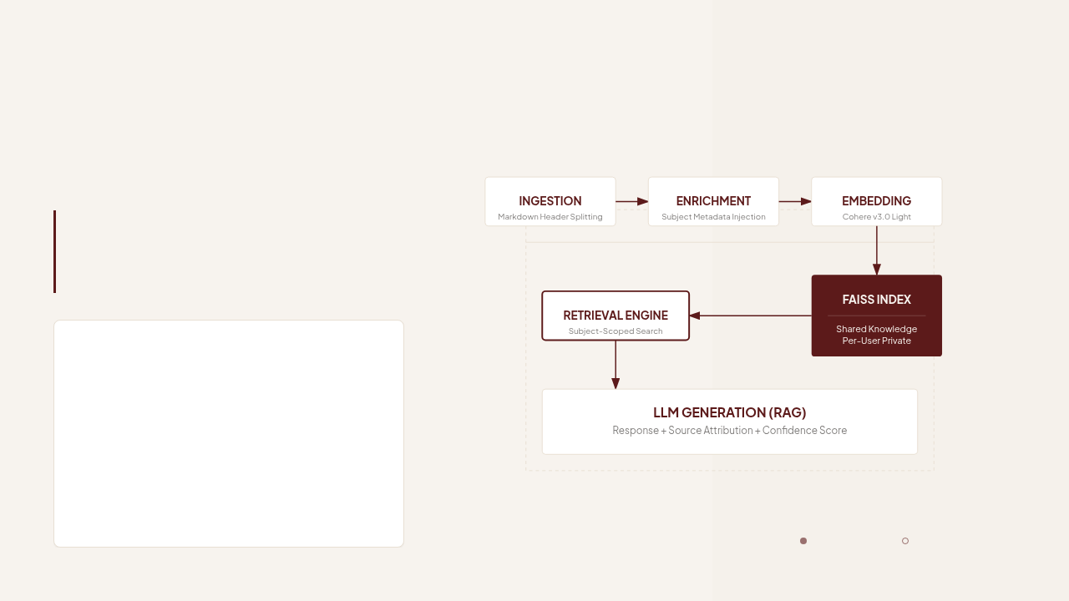
TECHNICAL ARCHITECTURE
RAG Pipeline
The RAG pipeline ensures that AI responses are
accurate, contextual, and deeply integrated with the
user's specific study content.
A sophisticated pipeline utilizing hierarchical
splitting, metadata enrichment, and dual-
index retrieval.
Pipeline Characteristics
Ingestion Engine
Markdown splitting by unit, chapter, and topic headers.
Vector Storage
Cohere embed-english-light-v3.0 embeddings in FAISS.
Scoped Retrieval
Similarity searches across shared and per-user indexes.
Attributed Generation
Final LLM responses with source attribution and confidence
scoring.
Core Engine
Technical Module

Slide 6
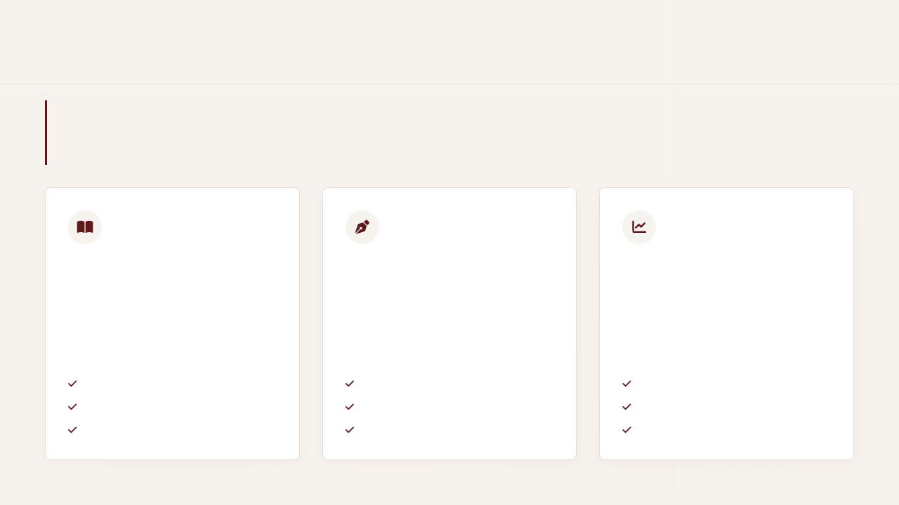
PART 1
Key Features
Integrated reader, editor, and dashboard provide a seamless environment for daily study tasks.
The platform offers a comprehensive suite of tools for reading, note-taking, and progress tracking within a unified
dashboard.
TOOL 01
TOOL 02
TOOL 03
Study Reader
Notes Editor
Dashboard
A feature-rich PDF viewer designed for deep
focus and structured reading.
A powerful writing environment optimized for
technical and academic content.
The command center for monitoring your
academic progress and growth.
TOC & Bookmark Navigation
Full Markdown Support
Activity Streak Tracking
Light, Dark, & Sepia Themes
AI-Generated Organization Tags
Reading Progress Metrics
Integrated Reading Timer
URL Reference Linking
Weak Topic Identification

Slide 7

ADVANCED AI CAPABILITIES
Key Features (Part 2)
AI-driven quizzes, chat, and roadmaps transform study material into an active learning
experience.
Quiz Generator
'Ask AI' Chat
Creates unit-scoped Multiple Choice Questions directly from your
study material to test comprehension and reinforce key concepts
automatically.
Subject-scoped RAG (Retrieval-Augmented Generation) chat
providing precise information with clear source attribution for every
answer provided.
Intelligent Roadmap
Growth Analytics
Generates personalized week-by-week study plans based on real-
time performance data and identified knowledge gaps to optimize
your learning path.
Comprehensive tracking of trends and subject-wise performance
metrics, visualizing student growth and focus areas over time with
technical precision.

Slide 8
SYSTEM ARCHITECTURE & RETRIEVAL
Technical Highlights
"Precision engineering through canonicalization, metadata tagging, and hybrid vector indexing."
Technical optimizations ensure data consistency, precise retrieval, and user trust through transparent AI processes.
Subject Canonicalization
Precise Metadata Tagging
The system implements normalization protocols to handle naming variations.
This ensures that disparate inputs
Granular subject scoping is achieved by tagging every individual data chunk
with unit-wise metadata. This allows the retrieval engine to filter content by
chapter, module, or specific learning objective with surgical precision.
Hybrid Vector Indexing
Source Attribution
Utilizing a Hybrid FAISS approach, the architecture maintains a sophisticated
dual-index system. It effectively manages a global shared knowledge base
while isolating private, per-user notes for secure, personalized retrieval.
To foster user trust, every AI-generated response includes explicit
source attribution to the specific unit or chapter. Responses are further
validated with a confidence score derived from retrieval depth.
FAISS Vector Engine v2.4
Traceable
Verified

Slide 9
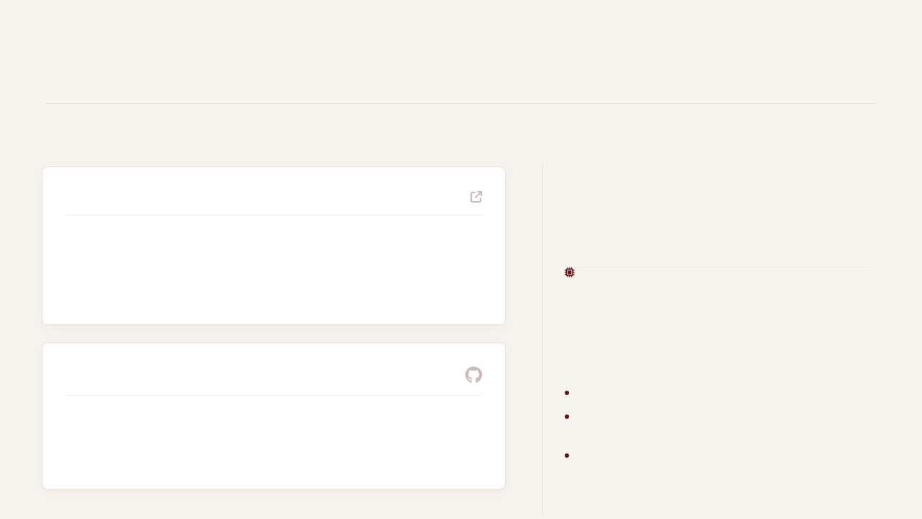
DEPLOYMENT & ACCESSIBILITY
Live Demo & Source
"The project is fully deployed, open-source, and ready for immediate evaluation and
reproduction."
10
LIVE APPLICATION
rag-v2-gules.vercel.app
Functionally Complete Modules
DEMO
Fully functional frontend hosted on Vercel with a high-performance backend running on
Render.
Full Reproducibility
The project is designed for immediate verification.
Anyone can clone the repository, install
dependencies, and run the environment to validate
the implementation logic and deployment status.
PUBLIC REPOSITORY
Clone and verify full-stack architectural integrity.
github.com/prateEKsaha07/RAG_v2
Immediate evaluation of retrieval-augmented
generation (RAG) capabilities.
Complete codebase featuring 10 functionally complete modules and full version history.
Production-ready deployment scripts included in the
source.

Slide 10

ROADMAP & EVOLUTION
Impact & Future Scope
"From a successful solo deployment to a collaborative, adaptive, and institution-ready platform."
CURRENT IMPACT
NEXT PHASE
FUTURE SCOPE
The project has successfully established a
grounded AI learning loop, proving the
core hypothesis of solo-built technical
efficacy.
TECHNICAL ROADMAP
Institutional Scaling
Transitioning from individual tools to college-
wide platform integration.
Mobile & Accessibility
Dedicated mobile app & text-to-speech
integration.
Administrative Controls
Centralized management system.
Successful deployment architecture
Enhanced Interaction
Validated user learning workflows
Document annotations & real-time study group
collaboration.
Institutional Accounts
Dedicated security & data silos.
Adaptive Intelligence
Dynamic quiz difficulty based on performance
metrics.

Slide 11

PROJECT SUMMARY
Conclusion
End-to-End Execution
The AI Study Assistant represents a complete execution of a
modern application, covering design, frontend, backend, AI
integration, and DevOps.
STATEMENT OF WORK
Solo-built.
Deployed. Live.
Open source.
And still improving.
MODULES
STATUS
10 Live
Functional
INFRASTRUCTURE
Public & Reproducible
VERCEL
RENDER
SUPABASE
GITHUB
A testament to technical proficiency and active development.
Any questions?
Thank you for your time.

